Slide 1
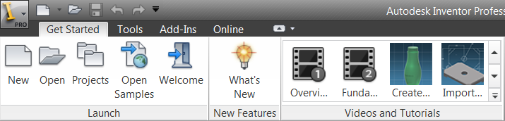
Customizing the User Interface
Presenter
Developer Technical Services

Slide 2
Agenda
The Ribbon User Interface
The Ribbon Interface
The Ribbon API - Object Model
Ribbon Elements
Ribbon considerations
Lab: Ribbon Creation
Creating a Command
Introduction to Commands
Command Behavior
Control Definitions and Command Controls
Lab: Command Creation

Slide 3
The Ribbon Interface
The ribbon is the default user-interface in Inventor.
The new interface based on the Microsoft ‘WPF’ technology
Replaces the existing menu and panel bars.
A new Quick Access toolbar can be used to store frequently used commands
Users will have the choice of ribbon or “classic” user-interface – from Inventor 2010

Slide 4
The Ribbon API
From Inventor 2010 API provides full support for the Ribbon.
Programs using API for “classic” interface will continue to work and will automatically have their controls added to the ribbon interface, but to have better placement of your controls you should take advantage of the Ribbon API.
UserInterfaceManager.InterfaceStyle property returns the currently displayed interface style.
ColorSchemes.InterfaceStyle property allowed to change the InterfaceStyle. Need to restart Inventor.

Slide 5
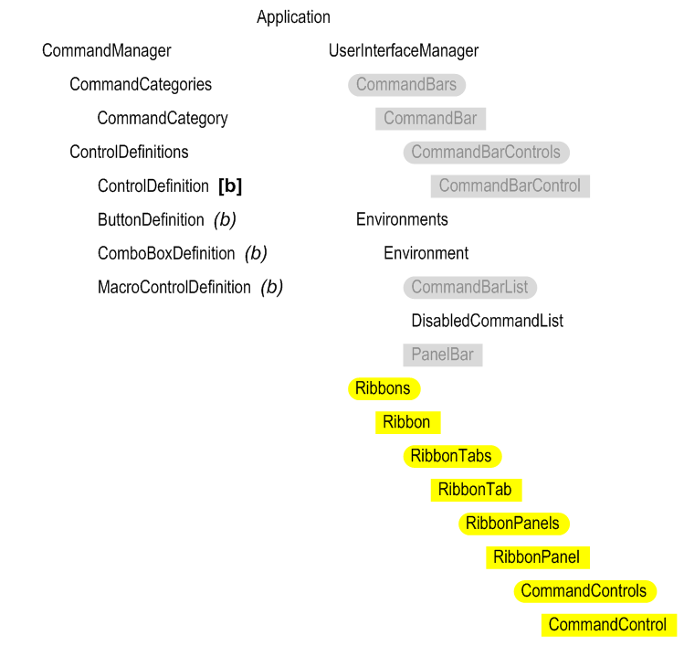
Ribbon API – Object Model
All of the previous UI related API is still exists.
The CommandManager functionalities are unchanged.
Need to create a ButtonDefinition to define the look and behavior of a button.
Ribbon related objects can be obtained from UserInterfaceManager object
Activate method of your add-in should be used for creation of ribbon objects.
Notes:
All of the previous UI related API is still there and works but will create items that can’t be seen in the ribbon interface.
The yellow items are the new objects that deal with the ribbon. They white objects are existing classes you can still use. The grey objects are now obsolete.
The functionality available through the CommandManager is unchanged and behaves the same. You still create a ButtonDefinition to define the look and behavior of a button.
New objects have been added under the UserInterfaceManager object to access the ribbon hierarchy. The creation of these objects should be done in the Activate method of your add-in.

Slide 6
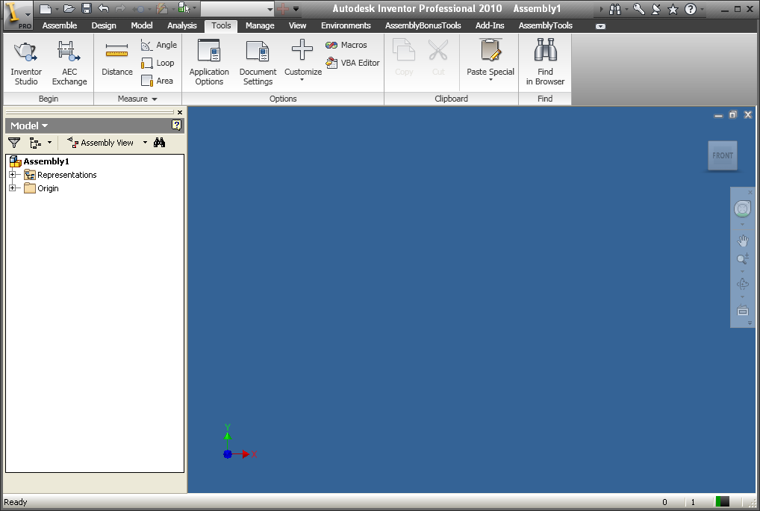
Ribbon Elements - Ribbon
Top-level object that provides access to all of the ribbon features.
Seven available ribbons:
ZeroDoc
Part
Assembly
Drawing
Presentation
iFeatures
UnknownDocument
New ribbons cannot be created, but existing ribbons can be modified.
Notes:
Now some details from the API perspective …
There are seven available Ribbons … Most of them are self-explanatory. The ZeroDoc Ribbon is the one that displays when there are no documents open. And the UnknownDocument Ribbon is displayed for two cases that don’t fit with the other environments; when editing a Notebook and when modifying the orientation when creating a drawing view.
You can’t create any additional Ribbons using the UI or API, but you can add your own elements to existing Ribbons.

Slide 7
Ribbon Elements - Ribbon
To determine whether the Inventor UI is set to classic UI or Ribbon UI
Print the 7 available Ribbon types in Inventor
Sub SwitchInterface()
Dim oUIMng As UserInterfaceManager
oUIMng = _InvApplication.UserInterfaceManager
If oUIMng.InterfaceStyle = InterfaceStyleEnum.kRibbonInterface Then
MsgBox("Currently Ribbon UI Interace")
' Needs restart of Inventor to take effect
_InvApplication.ColorSchemes.InterfaceStyle = InterfaceStyleEnum.kClassicInterface
Else
MsgBox("Classic UI Interface")
' Needs restart of Inventor to take effect
_InvApplication.ColorSchemes.InterfaceStyle = InterfaceStyleEnum.kRibbonInterface
End If
End Sub
Sub PrintRibbonNames()
Dim oUIMng As UserInterfaceManager
oUIMng = _InvApplication.UserInterfaceManager
Dim oRibbon As Ribbon
For Each oRibbon In oUIMng.Ribbons
Debug.Print(oRibbon.InternalName)
Next
End Sub
Notes:
Macro to Use InterfaceStyle to check UI style
Macro to print the list of available Ribbons internal name

Slide 8
Ribbon Elements - Tab
RibbonTab object provides workflow organization of the commands.
Can edit existing tabs.
Can create new tabs.
Tabs can be invisible.
Users can reorganize and set visibility of tabs.
Possibility to determine whether this tab is contextual
Notes:
Selecting a RibbonTab displays the group of Panels assigned to that Tab. The Tab is a logical grouping of commands for a particular workflow. For example, selecting the Model Tab shows all the commands you’re likely to need for manipulating a model.
From the API, you can edit existing tabs, you can create new ones, and you can set visibility.
The user can also reorganize tabs and set their visibility.
Contextual tabs, such as the Sketch tab in the Sketch environment, come and go based on the current environment. They are displayed in a different color to indicate to the user that this is not a permanent tab

Slide 9
Ribbon Elements - Tab
RibbonTabs.Add ( DisplayName ,
InternalName,
ClientId,
[ TargetTabInternalName ] ,
[ InsertBeforeTargetTab ],
[Contextual ] )
MyZeroDocTab = ZeroDocRibbon.RibbonTabs.Add("My ZeroDocTab", _
"id_ZDTab", _
"{5B9AA8AD-1D99-4957-8CB4-9870F23CBBFB}", _
"id_TabTools", True, False)
Notes:
DisplayName - Input string that defines the display name of the ribbon tab.
InternalName Input string that defines the unique internal name of the ribbon tab. This can used to find a specific tab.
ClientId - Input String that uniquely identifies the client. This is the CLSID of the AddIn in a string form, e.g. "{C9A6C580-3817-11D0-BE4E-080036E87B02}". It is not recommended to pass a “dummy” string or a null string.
TargetTabInternalName Optional , String that specifies existing tab to position the new tab next to.
InsertBeforeTargetTab Optional, Boolean value that specifies whether to position the new tab before or after the target ribbon tab. The argument defaults to False and is not used if the TargetTabInternalName argument is not specified.
Contextual Optional, Boolean that specifies whether this is a contextual tab.
Contextual tabs, such as the Sketch tab in the Sketch environment, come and go based on the current environment. They are displayed in a different color to indicate to the user that this is not a permanent tab. If not provided, this argument defaults to False. If a value of False is provided, the tab is added visibly. If a value of True is provided, the tab is added invisibly. Contextual tabs should then be added to the Environment.AdditionalVisibleRibbonTabs so that they show up visible in the appropriate environment(s).

Slide 10
Ribbon Elements - Tab
Add a RibbonTab by name “My ZeroDocTab” in the Zero Document Ribbon
Sub AddNewRibbonTab()
'Get the ZeroDoc
Dim ZeroDocRibbon As Ribbon
ZeroDocRibbon = _InvApplication.UserInterfaceManager.Ribbons.Item("ZeroDoc")
Dim MyZeroDocTab As RibbonTab
Try
MyZeroDocTab = ZeroDocRibbon.RibbonTabs.Item("id_ZDTab")
Catch
'Add a new RibbonTab afer the "Tools" Tab
MyZeroDocTab = ZeroDocRibbon.RibbonTabs.Add(“My ZeroDocTab", _
"id_ZDTab", _
"{5B9AA8AD-1D99-4957-8CB4-9870F23CBBFB}", _
"id_TabTools", _
False)
End Try
MyZeroDocTab.Visible = True
End Sub
Notes:
Print the list of Contextual Tabs display name in the Part document
Sub PrintContextualTabs()
Dim oUIManager As UserInterfaceManager
Set oUIManager = ThisApplication.UserInterfaceManager
Dim oRibbon As Ribbon
Set oRibbon = oUIManager.Ribbons.Item("Part")
Dim oRibbonTabs As RibbonTabs
Dim oRibbonTab As RibbonTab
Set oRibbonTabs = oRibbon.RibbonTabs
For Each oRibbonTab In oRibbonTabs
' Non Permanent visible tabs
If oRibbonTab.Contextual Then
Debug.Print oRibbonTab.DisplayName
End If
Next
End Sub

Slide 11
Ribbon Elements - Panel
RibbonPanel object allows organization of commands within a tab.
Can edit existing panels.
Can create new panels.
Panels can be invisible.
Panels can have an additional set of slide-out controls.
Users can reorganize, control visibility, and create floating panels.
Notes:
The RibbonPanel allows the logical grouping of commands within a tab. For example, thre Measure panel groups all the measurement tools.
As for Tabs, you can edit, create and set the visibility of panels. And you can also define slide-out controls. If you look at the Measure tab in the screenshot, you’ll see a little arrow. Clicking on that reveals more measurement controls (normally you’ll put the less often used controls in the slide-out).
Users can reorganize the panels, they can turn them on and off, and they can pull a panel off a tab to create a floating panel.

Slide 12
Ribbon Elements - Panel
RibbonPanels.Add ( DisplayName ,
InternalName,
ClientId,
[ TargetPanelInternalName ] ,
[ InsertBeforeTargetPanel ] )
MyToolsPanel = oAssemblyPanels.Add("My ToolsPanel", _
"id_mytoolspanels", _
"{5B9AA8AD-1D99-4957-8CB4-9870F23CBBFC}", _
"id_PanelA_ToolsMeasure", True)
Notes:
DisplayName - Input string that defines the display name of the ribbon Panel
InternalName Input string that defines the unique internal name of the ribbon Panel. This can used to find a specific Panel.
ClientId - Input String that uniquely identifies the client. This is the CLSID of the AddIn in a string form, e.g. "{C9A6C580-3817-11D0-BE4E-080036E87B02}". It is not recommended to pass a “dummy” string or a null string.
TargetPanelInternalName Optional , String that specifies existing tab to position the new Panel next to.
InsertBeforeTargetPanel Optional, Boolean value that specifies whether to position the new panel before or after the target ribbon panel.
The argument defaults to False and is not used if the TargetPanelInternalName argument is not specified.

Slide 13
Ribbon Elements - Panel
Toggles the visibility of the "WorkFeatures" panel in the Assembly document model tab
Sub TogglePanel()
Dim oAssemblyRibbon As Ribbon
oAssemblyRibbon = _InvApplication.UserInterfaceManager.Ribbons.Item("Assembly")
Dim oAssembleModelTab As RibbonTab
oAssembleModelTab = oAssemblyRibbon.RibbonTabs.Item("id_TabModel")
Dim oAssemblyPanels As RibbonPanels
oAssemblyPanels = oAssembleModelTab.RibbonPanels
'Get the WorkFeatures Ribbon panel by passing the internal name
Dim oWorkFeatureTabPanel As RibbonPanel
oWorkFeatureTabPanel = oAssemblyPanels.Item("id_PanelAssm_ModelWorkFeatures")
If oWorkFeatureTabPanel.Visible Then
oWorkFeatureTabPanel.Visible = False
Else
oWorkFeatureTabPanel.Visible = True
End If
End Sub
Notes:
Get the "Modify" panel in Part document "Model" tab and place it as first panel
Sub RepositionPanel()
Dim oRibbon As Ribbon
Set oRibbon = ThisApplication.UserInterfaceManager .Ribbons.Item("Part")
Dim oRibbonTabs As RibbonTabs
Dim oRibbonTab As RibbonTab
Set oRibbonTabs = oRibbon.RibbonTabs
Set oRibbonTab = oRibbonTabs.Item("id_TabModel")
'Reposition the Modify Panel as the first panel
Dim oRibbonPanel As RibbonPanel
Set oRibbonPanel = oRibbonTab.RibbonPanels.Item("id_PanelP_ModelModify")
oRibbonPanel.Reposition "id_PanelP_Model2DSketchCreate", False
End Sub

Slide 14
Ribbon Elements - Control
CommandControl object Represents all controls in a panel or menu.
Content is defined by a ControlDefinition object.
Behaves in similar way as the “classic” CommandBarControl object.
Can be invisible.
Can use small or large icon. (16x16 and 32x32)
Can be the various types of buttons or combo box.
Used to define separators in menus.
Notes:
And each panel groups together a number of controls. You can add a number of stock controls to your panels and customize their behavior.
These are very like the old CommandBar objects.
Visibility can be used to create the effect of a button changing its function according to context. You can create two buttons next to each other in a panel and toggle the visibility between them to make it look like the button is changing its icon and functionality. Inventor uses this approach itself.
Icons:
Classic Interface:
Small: 16 x 16
Large: 24 x 24
Ribbon Interface:
Small: 16 x 16
Large: 32 x 32
One thing to note is that separators are defined differently now. In the old UI, a separator was automatically added when you set the BeginGroup property for a control. Now it’s a separate object you have to add.

Slide 15
Ribbon Name Extraction
'dump Ribbon info
Public Sub PrintRibbon()
Dim oLogFile As String = "c:\temp\ribbon.txt"
Dim objWriter As New System.IO.StreamWriter(oLogFile, True)
Dim oControl As CommandControl
Dim oRibbon As Ribbon
For Each oRibbon In mApp.UserInterfaceManager.Ribbons
objWriter.WriteLine("Ribbon: " & oRibbon.InternalName)
Dim oTab As RibbonTab
For Each oTab In oRibbon.RibbonTabs
objWriter.WriteLine(" Tab: " & oTab.DisplayName & ", " & _
oTab.InternalName & ", Visible: " & oTab.Visible)
Dim oPanel As RibbonPanel
For Each oPanel In oTab.RibbonPanels
objWriter.WriteLine(" Panel: " & oPanel.DisplayName & ", " & _
oPanel.InternalName & ", Visible: " & oPanel.Visible)
For Each oControl In oPanel.CommandControls
objWriter.WriteLine("Control: " & oControl.DisplayName & ", " & _ oControl.InternalName & ", Visible: " & oControl.Visible)
Next
Next
Next
Next
objWriter.Close()
End Sub
Notes:
This is useful code to get the internal names of the ribbons, tabs, panels, and controls so that you can use those to position your controls. This is demonstrated in the code in the previous slide.

Slide 16
Ribbon Considerations
Add-In’s Activate method should support both ribbon and classic user interfaces:
ControlDefinition creation is the same for both.
In Activate and when FirstTime is True check the value of UserInterfaceManager.InterfaceStyle and use the API to create either ribbon or classic controls.
Need to determine the most logical location for your commands. Where will the user most likely look for your functionality?
Do they consider your command an enhancement to basic Inventor functionality? Then consider adding it to an existing panel.
Do they consider your command a specialized command? Then consider creating a new panel that contains all of your commands.
Can take advantage of visibility control and only show your tab, panel, or control when the functionality should be available.
Environments are also supported by the ribbon and API.

Slide 17
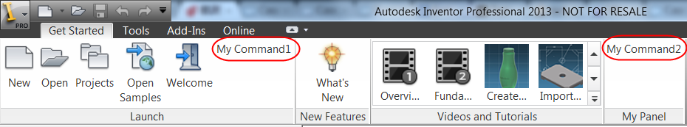
Lab: Ribbon API
Using a .Net Addin:
Add a Button to the ZeroDoc Ribbon in the Launch Panel available in the “Get Started” tab. Let the button have Large icon
Add a new panel to the ZeroDoc – Get Started Tab with two button controls in the panel
Notes:
Add a new Tab and a panel to the Part Document with few button controls in it

Slide 18
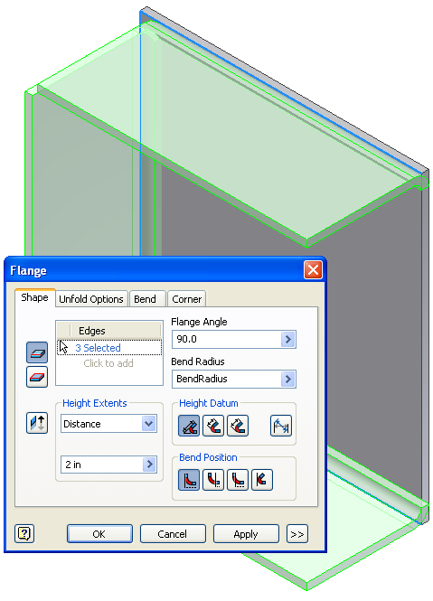
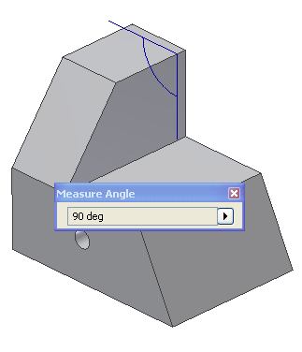
Command behavior From User Perspective
For more complex commands, a dialog is used to gather the required input.
Selection behavior is specific to that command.
Previews of the possible results are shown.
Executing another command terminates the current command.
Exception of view commands that just temporarily suspend the current command.

Slide 19
Commands From the API Perspective
Commands don’t exist as a single concept.
Commands are created using a combination of API functionalities:
User interface items (buttons, combo boxes, etc...) are created to allow the end-user to invoke your functionality.
The command “behavior” is provided through the InteractionEvents object, your own dialogs and possibly Client Graphics: termination of current command, gathering user inputs, providing dynamic visual feedbacks.
Notes:
For more information about using InteractionEvents see module 12 Events
For more information about using Client Graphics see module 16

Slide 20
Buttons and Other Controls
A button, as seen by the end-user, is defined through the creation of two objects: ControlDefinition and CommandControl (or CommandBarControl in 2009 and previous releases).
The ControlDefinition object is the base class for:
ButtonDefinition - standard button
ComboBoxDefinition - combo box
MacroControlDefinition - button that executes a VBA macro
More (please see help reference)
ControlDefinition objects also exist for all of the built-in Inventor commands.

Slide 21
Control Definitions vs. Controls
A ControlDefinition object defines how a control will look and behave but it does not define where a control exists in the user interface.
A CommandControl object represents the physical button, or other control.
A CommandControl references a ControlDefinition. Changing the ControlDefinition causes all the associated controls to update.
Notes:
'List all commands which Internal Name contains CmdName
Public Function FindCommandByInternalName(CmdName As String)
'Gets CommandManager's Control Definitions
Dim oControlDefs As ControlDefinitions
Set oControlDefs = ThisApplication.CommandManager.ControlDefinitions
'Iterates trough all Control Definitions and prints InternalName and DescriptionText
'of commands that match a part of the input string
Dim oControlDef As ControlDefinition
For Each oControlDef In oControlDefs
If InStr(oControlDef.InternalName, CmdName) <> 0 Then
Debug.Print "[Internal Name]" & oControlDef.InternalName & Space(45 - Len(oControlDef.InternalName)) & " [Description]" & oControlDef.DescriptionText
End If
Next
End Function
Public Function FindCommandBarByInternalName(CmdBarName As String)
Dim oComBars As CommandBars
Set oComBars = ThisApplication.UserInterfaceManager.CommandBars
Dim oBar As CommandBar
For Each oBar In oComBars
If InStr(oBar.InternalName, CmdBarName) <> 0 Then
Debug.Print "[Internal Name] " & oBar.InternalName & Space(45 - Len(oBar.InternalName)) & " [Description]" & oBar.DisplayName
End If
Next
End Function
Public Sub TestFindCommandBar()
Call FindCommandBarByInternalName("Part")
End Sub
Public Sub TestFindCommand()
Call FindCommandByInternalName("Punch")
End Sub

Slide 22
Creating a ControlDefinition
ControlDefinitions.AddButtonDefinition Method:
Sub AddButtonDefinition(
DisplayName As String,
InternalName As String,
Classification As CommandTypesEnum,
ByRef ClientId As [optional] VARIANT,
ByRef DescriptionText As [defaultvalue("")] BSTR,
ByRef TooltipText As [defaultvalue("")] BSTR,
ByRef StandardIcon As [optional] VARIANT,
ByRef LargeIcon As [optional] VARIANT,
ByRef ButtonDisplay As ButtonDisplayEnum,
Result As [out, retval] ButtonDefinition*)

Slide 23
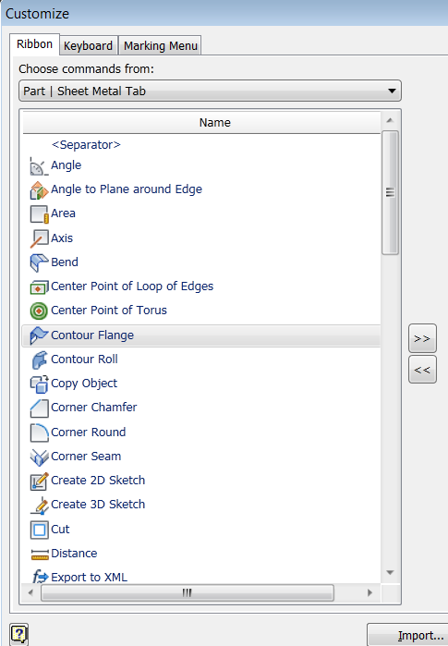
Command Categories
Command Categories can be created so your "commands" (Control Definitions) are grouped within the Customize dialog.

Slide 24
When to Create User Interface elements
You need to pay attention to the FirstTime argument in the Activate method of your Add-In.
ApplicationAddInServer_Activate( _ ByVal AddInSiteObject As ApplicationAddInSite, _ ByVal FirstTime As Boolean)
The FirstTime argument is True the first time your Add-In is activated for the current user.
Every time your Add-In is activated you create your ControlDefinition objects.
Only when the FirstTime argument is True you create command bars, command bar controls, and set environment information.
After your Add-In has been started for the first time, Inventor remembers the UI changes you made so there’s no need to recreate them.
Notes:
Note: From Inventor 2010, the first time flag is always true so your UI changes are not persisted and you will need to recreate them each time your addin starts.

Slide 25
Button and Ribbon Sample
Public Sub Activate(. . . ) Implements Inventor.ApplicationAddInServer.Activate
Dim oCtrlDefs As ControlDefinitions = m_inventorApplication.CommandManager.ControlDefinitions
mButtonDef = oCtrlDefs.AddButtonDefinition("Custom Cmd", "Company:AddInName:Buton1", _
CommandTypesEnum.kQueryOnlyCmdType, "AddInGuid", _
"Description", "Tolltip text", Nothing, Nothing, _
ButtonDisplayEnum.kDisplayTextInLearningMode)
Dim oUIMng As UserInterfaceManager = InvApplication.UserInterfaceManager
If oUIMng.InterfaceStyle = InterfaceStyleEnum.kRibbonInterface Then
'Add command to the File controls.
Dim fileControls As CommandControls = oUIMng.FileBrowserControls
fileControls.AddButton(mButtonDef)
'Get the assembly ribbon.
Dim assemblyRibbon As Inventor.Ribbon = oUIMng.Ribbons.Item("Assembly")
'Get the "Assemble" tab.
Dim assemblyTab As Inventor.RibbonTab = assemblyRibbon.RibbonTabs.Item("id_TabAssemble")
'Create a new panel on the Assemble tab.
Dim panel As Inventor.RibbonPanel = assemblyTab.RibbonPanels.Add("Custom commands", _
"Company:AddInName:Panel1", "AddInGuid")
panel.CommandControls.AddButton(mButtonDef, True)
Else
'Perform classic UI initialisation
End If
AddHandler mButtonDef.OnExecute, AddressOf Me.mButtonDef_OnExecute 'Add handler VB.Net style
End Sub
Notes:
Always when the AddIn gets loaded and the Activate method is called we create our button definition.
Based on that definition we create a control if the AddIn is activated for the first time.
Why we only create the control for the first time, is that from then onwards the user can do with it what he wants, and Inventor will store the changes and keep them for the next session, where we only need to create our button definition which will create a connection between the controls referencing it and the functionality provided by it.

Slide 26
Lab: Command creation
Using the existing Add-In created in a previous lab:
Add code to define a ButtonDefinition object. Add an icon if you would like to.
Add code that creates a button control and adds it to the Part Model Tab
When the button is pressed display a message box indicating the button has been clicked.

Slide 27
Using an Icon for a Button (1)
Bitmaps and Icons can be saved as resources
In this case MyIcon.ico is an Embedded Resource
Used as input when creating the button definition
Inventor expects an IPictureDisp object
.Net uses the new Image type for bitmaps
Dim myStream As System.IO.Stream = _ Me.GetType().Assembly.GetManifestResourceStream("MyAddIn.MyIcon.ico")
Dim myIcon As Icon = New Icon(myStream)
Notes:
Old way to Convert from Image (or Icon) to IPictureDisp: It’s fairly easy to use resource in .NET. You just get its stream from the assembly, then can create the given object from it – e.g. an Icon Since Inventor is using IPictureDisp as images for the buttons, you need to convert the .NET image into that, whether it’s an Image or Icon object.
Reference and Imports System.Drawing and Microsoft.VisualBasic.Compatibility.
Dim myIPictureDisp As Object = _ Microsoft.VisualBasic.Compatibility.VB6.Support.IconToIPicture(myIcon)
VisualBasic.Compatibility is obsolted

Slide 28
Using an Icon for a Button (2)
Convert from Image (or Icon) to IPictureDisp
Old way (VisualBasic.Compatibility.VB6 is obsolete)
New way (AxHost)
Dim myIPictureDisp As Object = _ Microsoft.VisualBasic.Compatibility.VB6.Support.IconToIPicture(myIcon)
Friend Class AxHostConverter
Inherits AxHost
Private Sub New()
MyBase.New("")
End Sub
Public Shared Function ImageToPictureDisp(image As Image) As stdole.IPictureDisp
Return DirectCast(GetIPictureDispFromPicture(image), stdole.IPictureDisp)
End Function
Public Shared Function PictureDispToImage(pictureDisp As stdole.IPictureDisp) As Image
Return GetPictureFromIPicture(pictureDisp)
End Function
End Class
Dim oStream1 As System.IO.Stream = Me.GetType().Assembly.GetManifestResourceStream("ZeroRibbon.Tools.ico")
Dim oIcon1 As Icon = New Icon(oStream1)
Dim oIPictureDisp1 As Object = AxHostConverter.ImageToPictureDisp(oIcon1.ToBitmap())

Slide 29

Notes:
Thank you!
Questions?

